Slide 1
Conducting your survey using Qualtrics

Slide 2
What is Qualtrics?
Qualtrics is an online survey hosting software
Contains a variety of question layouts
Easily administered to participants

Slide 3
Most Useful Types of Questions in Qualtrics
For statistical analysis

Slide 4
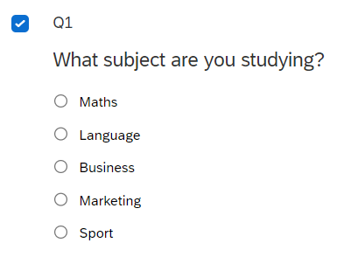
Multiple Choice
Can allow one or more options ticked
Can change number of options
Ensure options are exhaustive

Slide 5
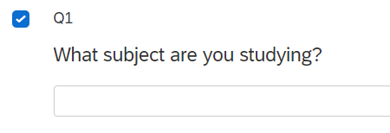
Free Text
Allows participants to write anything they want
Will require categorising of responses or qualitative analysis
Be careful with the same answer written differently

Slide 6
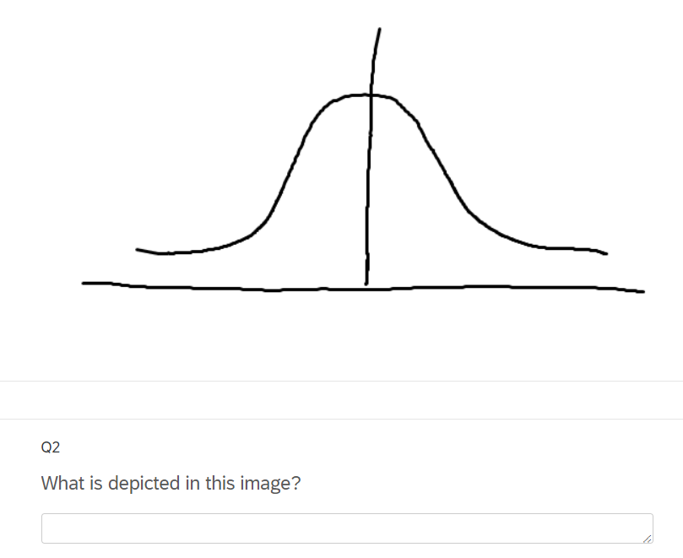
Adding images
You can use the Text/Graphic option to add an image to your survey
You can then ask a question about it by adding a new question above or below

Slide 7
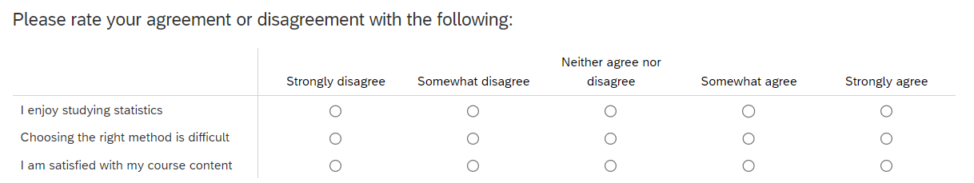
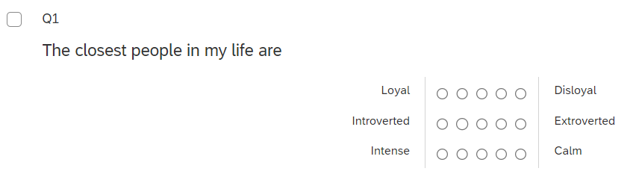
Matrix Table
Can add a LIKERT scale automatically
Can ask to compare between characteristics
Ensure a mix of positive and negative wording

Slide 8
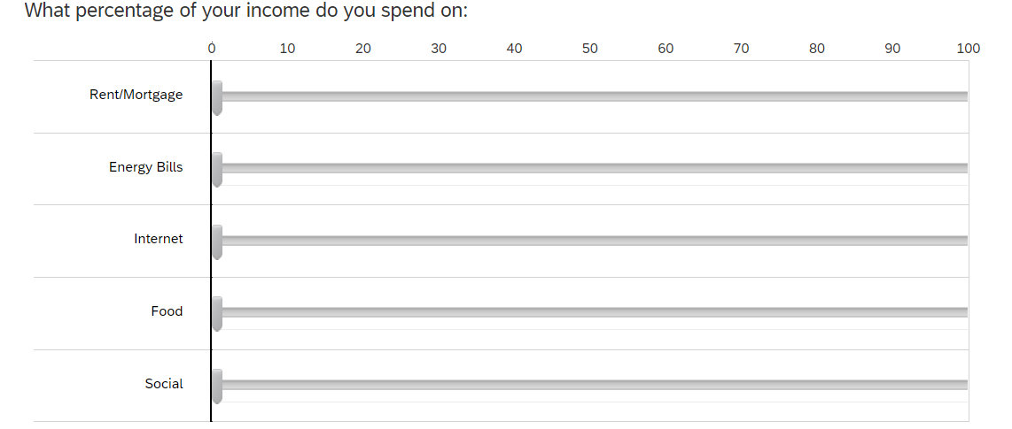
Sliders
Can be useful to allocate a percentage across factors
Not useful for free text or multiple choice questions

Slide 9
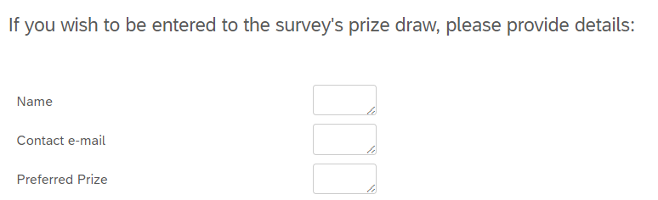
Form Field
Can group together a series of short-answer questions
Can be used at the end of a survey to ask for follow-up information
Only do this at the end and if necessary

Slide 10
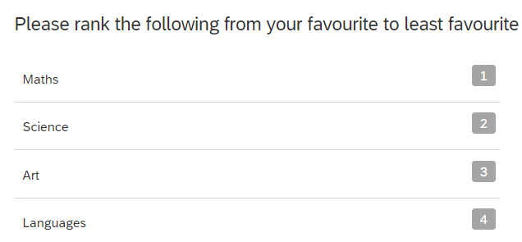
Ranking
Allows participants to order items
Can be difficult to analyse in detail
Can focus on frequency of highest and lowest ranks

Slide 11
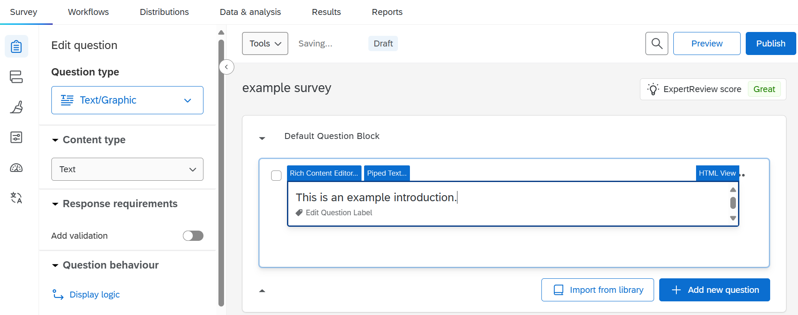
Add an introduction to your survey by including a Text/Graphics question in your first question block

Slide 12
Distributing Your Survey

Slide 13
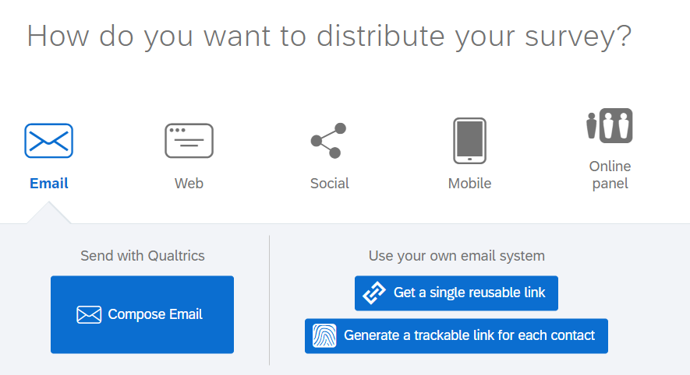
Distributions tab on Qualtrics

